Slide 1


An Overview of Georgia's New
Hotel-Motel Fee and Sales Tax on Accommodations
Commissioner Lynne Riley and
Amy Oneacre, Department of Revenue
#GaGTC15

Slide 2
What is it?
$5 per night fee on the first 30 consecutive days of a hotel room rental.

Slide 3
Why the fee?
House Bills 170 and 106

Slide 4
When?
July 1, 2015
The fee applies to all hotel room rentals that occur and are paid for on or after July 1, 2015.

Slide 5
Who charges the fee?
“Hotels”
What is a “hotel”?
A building with 5 or more “hotel rooms” under common ownership

Slide 6
What is a “hotel room”?
A room or (suite of rooms offered as a single accommodation)
that is used to provide private sleeping accommodations and
that typically includes linen or housekeeping service.

Slide 7
What is a “hotel room”?
“Private” means the customer has the right to exclude other customers from the room.

Slide 8
Is this a hotel?
Single property with 10 free-standing cabins
Each cabin is offered as a single accommodation

Slide 9
Answer.
No.

Slide 10
Is this a hotel room?
Facility rents beds for the night
Each room has more than one bed
Customers cannot exclude other customers from the room

Slide 11
Answer.
No.

Slide 12
Is this a hotel room?
a suite with two bedrooms, two bathrooms, and a kitchen offered at $400 per night

Slide 13
Answer.
Yes.

Slide 14
Extended Stays
The fee applies to the first 30 consecutive days of a hotel room rental.
After the 30th consecutive day, the fee no longer applies.
The fee collected on the 30-day stay will NOT be refunded.

Slide 15
Breaking the Extended Stay
If the customer checks out and back in again, the customer must pay the fee again every day until the 31st consecutive day of the new stay.

Slide 16
Breaking the Extended Stay
Moving to a different hotel breaks the stay.
Moving to a different room in the same hotel does NOT break the stay.

Slide 17
Is the fee subject to sales tax?
No, if separately stated on the invoice.

Slide 18
Who is exempt from the fee?
The federal government
Foreign diplomats

Slide 19
Federal Government Exemption
Check from a federal government account
Credit card centrally billed
Purchase order

Slide 20
Foreign Diplomat Exemption
For more info:
Policy Bulletin SUT-2014-02 Foreign Diplomat Tax Exemption Privileges

Slide 21
Exemptions
State and local government are NOT exempt.
Sales and use tax exemptions do NOT apply to the fee.
Local hotel excise tax exemptions do NOT apply to the fee.

Slide 22
Does the fee apply to
complimentary rooms?
No.

Slide 23
Does the fee apply to
a room provided to an employee free of charge?
Yes, if the room is included in the employee’s federal wages.

Slide 24
Does the fee apply to
BOGOs?
Yes.

Slide 25
BOGO example:
“Buy 4 nights, get the 5th night free.”
Fee=$25
($5 x 5 nights)

Slide 26
BOGO example:
“Rent 50 rooms, get 1 room free.”
Fee per night=$255
($5 x 51 rooms)

Slide 27
Does the fee apply to
rooms purchased by redeeming reward points?
Yes, if the hotel receives consideration (e.g., from a fund, a third party, or the customer).
Notes:
(e.g. from fund, the customer, or a third party)

Slide 28
Does the fee apply to
no-shows?
Yes, if the customer pays and the room is not re-offered.
Notes:
It doesn’t matter if the customer actually stays in the room.

Slide 29
Does the fee apply to
student housing?
No. A facility providing housing to students pursuant to a contract with a school is not subject to the fee, so long as the facility does not provide housekeeping, linen, or other customary hotel services.

Slide 30
Travel Reservation Companies
If a third-party travel reservation company contracts with a hotel to collect taxes and/or fees, then the Department may assess and collect state hotel-motel fees from either the hotel or the reservation company.

Slide 31
How to report and remit?
Electronic reporting & EFT only
Register and report on
Georgia Tax Center
gtc.dor.ga.gov

Slide 32
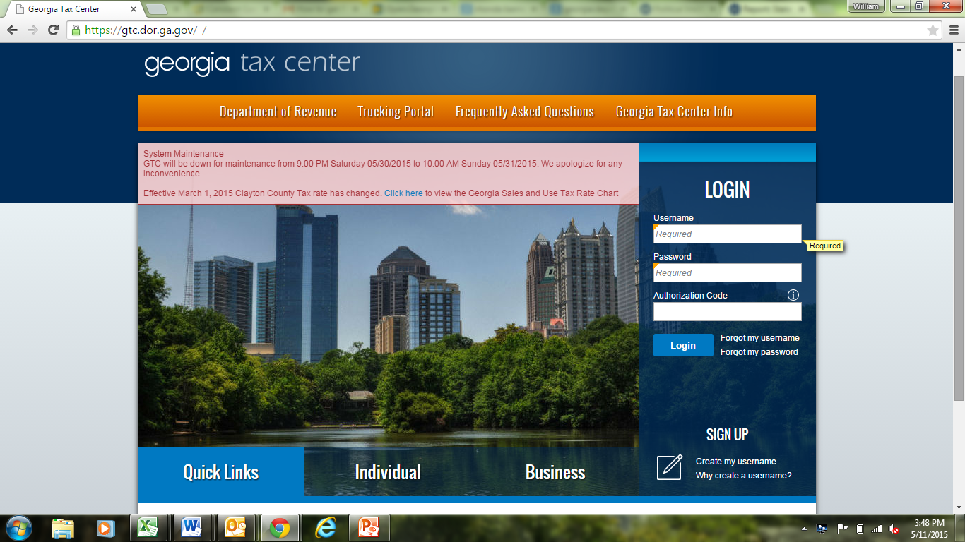
https://gtc.dor.ga.gov

Slide 33
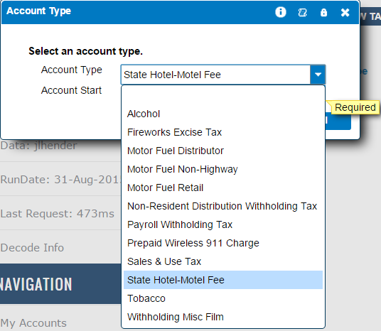

Slide 34
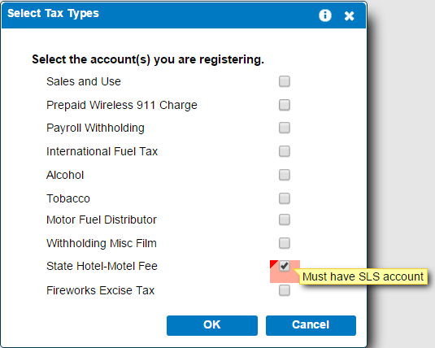

Slide 35
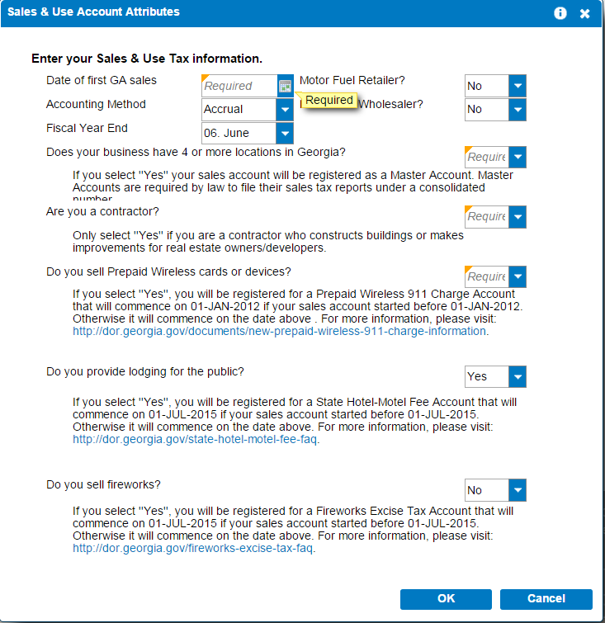

Slide 36
How to report and remit?
Each seller needs:
a sales tax number
+
a state hotel-motel fee number (HMF-000000)

Slide 37
How to report and remit?
1 state hotel-motel fee number per seller, even if the seller has more than 1 location.
1 return per seller, even if the seller has more than 1 location.

Slide 38
When to report and remit?
20th day of the month following the month of collection.
“Zero” returns are required.

Slide 39
Vendor’s Compensation
3% of the first $3,000.00 reported per location
+
.05% of remainder reported per location

Slide 40
Penalties
  $5.00 or 5% of tax, whichever is greater, per month with a maximum of $25.00 or 25%, whichever is greater
Interest
1% per month

Slide 41
Where to find information about the fee?

Slide 42

The FAQ

Slide 43
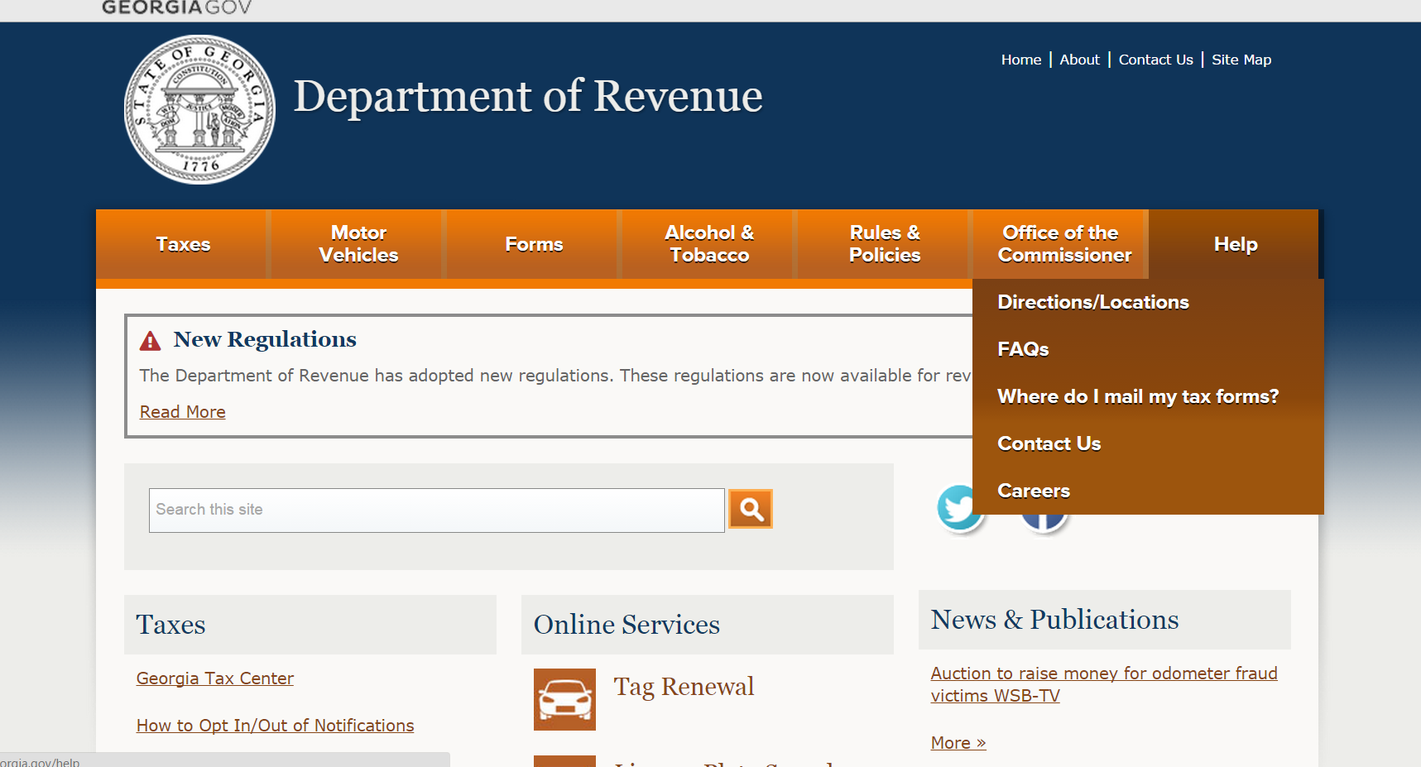
The FAQ

Slide 44

The FAQ

Slide 45

The FAQ

Slide 46
The Regulation
Emergency Rule 560-13-2-.30-.01

Slide 47
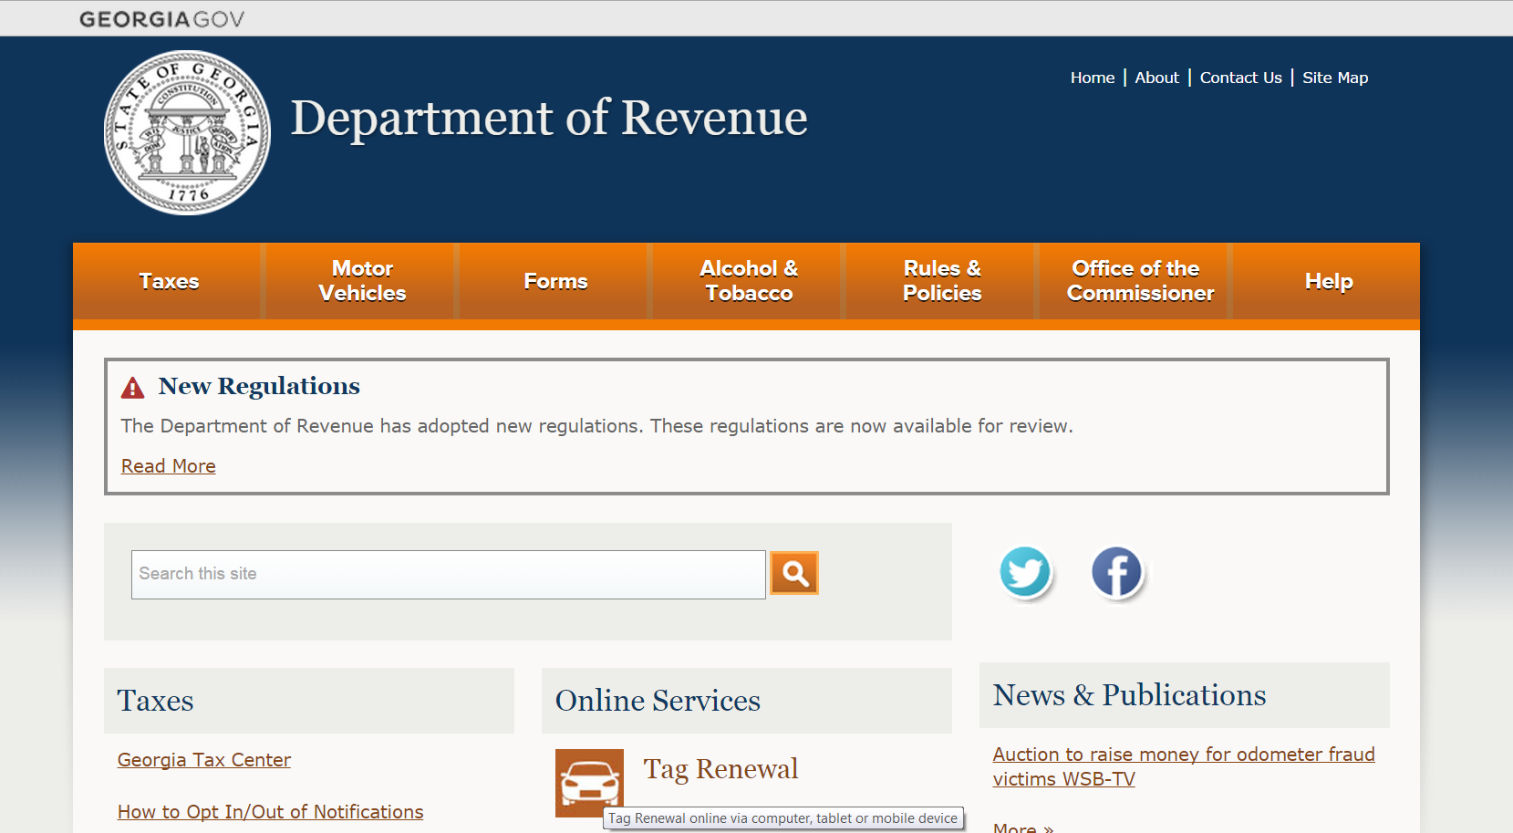
The Regulation

Slide 48
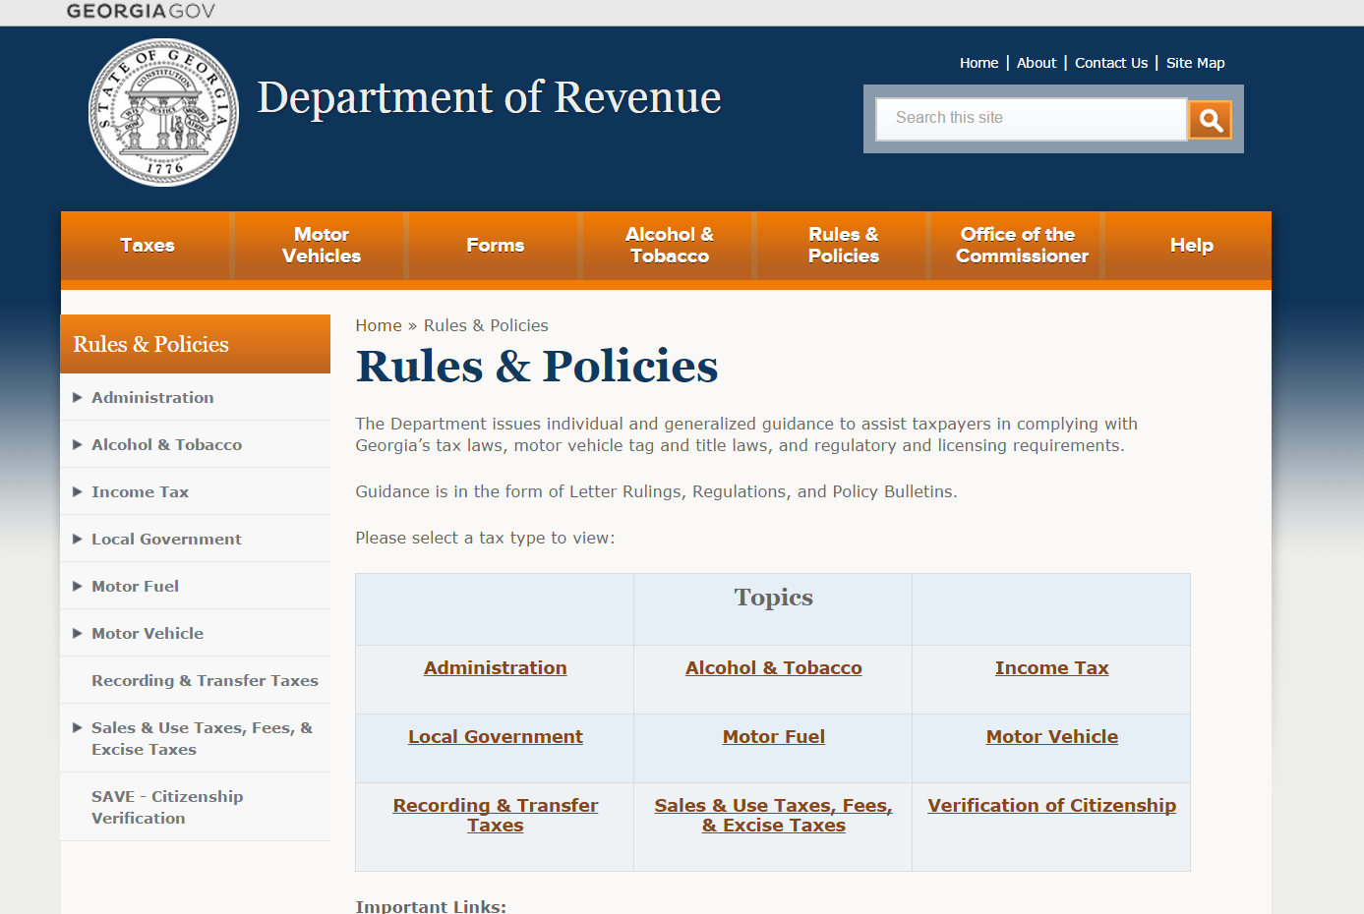
The Regulation

Slide 49
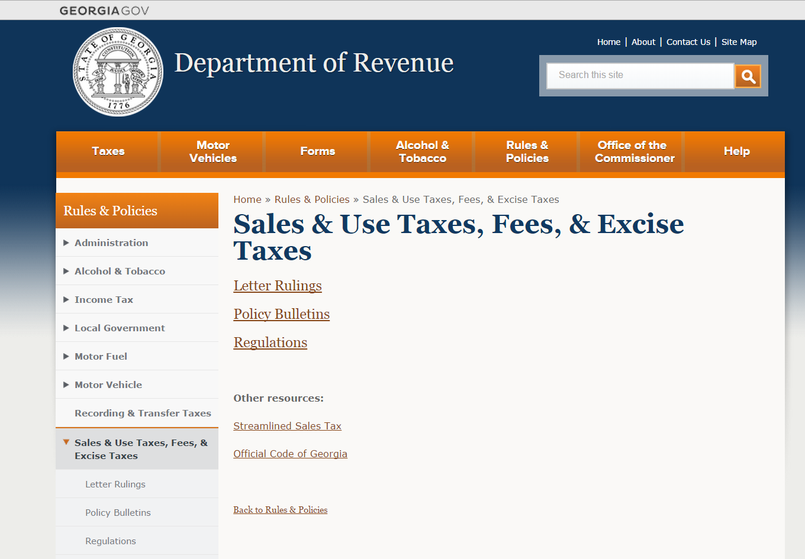
The Regulation

Slide 50
Sign up to receive updates!

Slide 51

The Revenue Messenger

Slide 52

The Revenue Messenger

Slide 53

The Revenue Messenger

Slide 54
Lynne Riley, Commissioner
1800 Century Boulevard, Suite 15300
Atlanta, GA 30345
Lynne.Riley@dor.ga.gov
404-417-2100
Amy Oneacre, Assistant Director
1800 Century Boulevard, Suite 15206
Atlanta, GA 30345
Amy.Oneacre@dor.ga.gov
404-417-6628
http://dor.georgia.gov

